Slide 1

Chapter 11 – Input/Output and Exception Handling

Slide 2
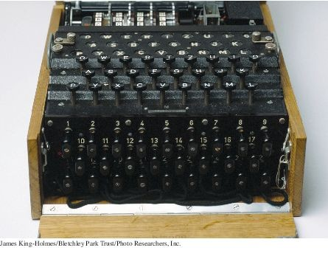
Chapter Goals
To read and write text files
To process command line arguments To throw and catch exceptions
To implement programs that propagate checked exceptions

Slide 3
Reading and Writing Text Files - Reading
Use Scanner class for reading text files To read from a disk file:
Construct a File object representing the input file
File inputFile = new File("input.txt");
Use this File object to construct a Scanner object:
Scanner in = new Scanner(reader);
Use the Scanner methods to read data from file
next, nextInt, and nextDouble

Slide 4
Reading and Writing Text Files - Reading
A loop to process numbers in the input file:
while (in.hasNextDouble())
{
double value = in.nextDouble();
Process value.
}

Slide 5
Reading and Writing Text Files - Writing
To write to a file, construct a PrintWriter object:
PrintWriter out = new PrintWriter("output.txt");
If file already exists, it is emptied before the new data are written into it.
If file doesn't exist, an empty file is created.
Use print and println to write into a PrintWriter:
out.println("Hello, World!"); out.printf("Total: %8.2f\n", total);
You must close a file when you are done processing it:
in.close();
out.close();
Otherwise, not all of the output may be written to the disk file. An optional character encoding can be specified as the second parameter to Scanner and PrintWriter constructor
Should specify "UTF-8" as the second parameter when constructing a Scanner or a PrintWriter.

Slide 6
FileNotFoundException
When the input or output file doesn't exist, a
FileNotFoundException can occur.
To handle the exception, label the main method like this:
public static void main(String[] args) throws FileNotFoundException

Slide 7
Reading and Writing Text Files - Example
Read a file containing numbers
Sample input
32 54 67.5 29 35 80
115 44.5 100 65
Write the numbers in a column followed by their total
Output from sample input
32.00
54.00
67.50
29.00
35.00
80.00
115.00
44.50
100.00
65.00
Total: 622.00

Slide 8
section_1/Total.java
import java.io.File;
import java.io.FileNotFoundException;
import java.io.PrintWriter;
import java.util.Scanner;
5
6
7
8
9
/**
This program reads a file with numbers, and writes the numbers to another file, lined up in a column and followed by their total.
*/

Slide 9
Self Check 11.1
What happens when you supply the same name for the input and output files to the
Total program? Try it out if you are not sure.
Answer: When the PrintWriter object is created, the output file is emptied. Sadly, that is the same file as the input file. The input file is now empty and the while loop exits immediately.

Slide 10
Self Check 11.2
What happens when you supply the name of a nonexistent input file to the Total
program? Try it out if you are not sure.
Answer: The program throws a FileNotFoundException and terminates.

Slide 11
Self Check 11.3
Suppose you wanted to add the total to an existing file instead of writing a new file. Self Check 1 indicates that you cannot simply do this by specifying the same file for input and output. How can you achieve this task? Provide the pseudocode for the solution.
Answer:
Open a scanner for the file. For each number in the scanner
Add the number to an array.
Close the scanner. Set total to 0.
Open a print writer for the file. For each number in the array
Write the number to the print writer. Add the number to total.
Write total to the print writer. Close the print writer.

Slide 12
Self Check 11.4
How do you modify the program so that it shows the average, not the total, of the inputs?
Answer: Add a variable count that is incremented whenever a number is read. At the end, print the average, not the total, as
out.printf("Average: %8.2f\n", total / count);
Because the string "Average" is three characters longer than "Total", change the other output to out.printf("%18.2f\n", value).

Slide 13
Self Check 11.5
How can you modify the Total program so that it writes the values in two columns, like this:
32.00 | 54.00
67.50 | 29.00
35.00 | 80.00
115.00 | 44.50
100.00 | 65.00
Total: | 622.00
Answer: Add a variable count that is incremented whenever a number is read. Only write a new line when it is even.
count++; out.printf("%8.2f", value);
if (count % 2 == 0) { out.println(); }
At the end of the loop, write a new line if count is odd, then write the total:
if (count % 2 == 1) { out.println(); } out.printf("Total: %10.2f\n", total);

Slide 14
Text Input and Output
The next method of the Scanner class reads a string that is delimited by white space.
A loop for processing a file
while (in.hasNext())
{
String input = in.next(); System.out.println(input);
}
If the input is "Mary had a little lamb", the loop prints each word on a separate line
Mary had a
little lamb

Slide 15
Text Input and Output
The next method returns any sequence of characters that is not white space.
White space includes: spaces, tab characters, and the newline characters that separate lines.
These strings are considered "words" by the next method
snow. 1729 C++
When next is called:
Input characters that are white space are consumed - removed from the input They do not become part of the word
The first character that is not white space becomes the first character of the word
More characters are added until
Either another white space character occurs Or the end of the input file has been reached
If the end of the input file is reached before any character was added to the word
a “no such element exception” occurs.

Slide 16
Text Input and Output
To read just words and discard anything that isn't a letter:
Call useDelimiter method of the Scanner class
Scanner in = new Scanner(. . .); in.useDelimiter("[^A-Za-z]+");
. . .
The word separator becomes any character that is not a letter.
Punctuation and numbers are not included in the words returned by the next method.

Slide 17
Text Input and Output - Reading Characters
To read one character at a time, set the delimiter pattern to the empty string:
Scanner in = new Scanner(. . .); in.useDelimiter("");
Now each call to next returns a string consisting of a single character.
To process the characters:
while (in.hasNext())
{
char ch = in.next().charAt(0);
Process ch
}

Slide 18
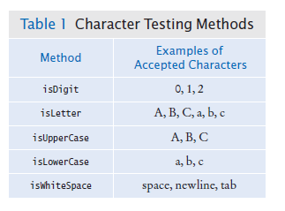
Text Input and Output - Classifying Characters
The Character class has methods for classifying characters.

Slide 19
Text Input and Output - Reading Lines
The nextLine method reads a line of input and consumes the newline character at the end of the line:
String line = in.nextLine();
The hasNextLine method returns true if there are more input lines, false when all lines have been read.
Example: process a file with population data from the CIA Fact Book with lines like this:
China 1330044605
India 1147995898
United States 303824646
...
Read each input line into a string
while (in.hasNextLine())
{
String line = nextLine();
Process line.
}

Slide 20
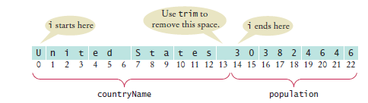
Text Input and Output - Reading Lines
Then use the isDigit and isWhitespace methods to find out where the name ends and the number starts.
To locate the first digit:
int i = 0;
while (!Character.isDigit(line.charAt(i))) { i++; }
To extract the country name and population:
String countryName = line.substring(0, i); String population = line.substring(i);
Use trim to remove spaces at the beginning and end of string:
countryName = countryName.trim();
Note that the population is stored in a string.

Slide 21
Text Input and Output - Scanning a String
Occasionally easier to construct a new Scanner object to read the characters from a string:
Scanner lineScanner = new Scanner(line);
Then you can use lineScanner like any other Scanner object, reading words and numbers:
String countryName = lineScanner.next(); while (!lineScanner.hasNextInt())
{
countryName = countryName + " " + lineScanner.next();
}
int populationValue = lineScanner.nextInt();

Slide 22
Text Input and Output - Converting Strings to Numbers
If a string contains the digits of a number.
Use the Integer.parseInt or Double.parseDouble method to obtain the number value.
If the string contains "303824646"
Use Integer.parseInt method to get the integer value
int populationValue = Integer.parseInt(population);
// populationValue is the integer 303824646
If the string contains "3.95"
Use Double.parseDouble
double price = Double.parseDouble(input);
// price is the floating-point number 3.95
The string must not contain spaces or other non-digits. Use trim:
int populationValue = Integer.parseInt(population.trim());

Slide 23
Avoiding Errors When Reading Numbers
If the input is not a properly formatted number when calling
nextInt or nextDouble method
input mismatch exception occurs
For example, if the input contains characters:
White space is consumed and the word 21st is read. 21st is not a properly formatted number
Causes an input mismatch exception in the nextInt method.
If there is no input at all when you call nextInt or nextDouble,
A “no such element exception” occurs.
To avoid exceptions, use the hasNextInt method
if (in.hasNextInt())
{
int value = in.nextInt();
. . .
}

Slide 24
Mixing Number, Word, and Line Input
The nextInt, nextDouble, and next methods do not
consume the white space that follows the number or word.
This can be a problem if you alternate between calling nextInt/ nextDouble/next and nextLine.
Example: a file contains country names and populations in this format:
China 1330044605
India 1147995898
United States 303824646
The file is read with these instructions:
while (in.hasNextLine())
{
String countryName = in.nextLine(); int population = in.nextInt(); Process the country name and population.
}

Slide 25


Mixing Number, Word, and Line Input
Initial input
Input after first call to nextLine
Input after call to nextInt
nextInt did not consume the newline character
The second call to nextLine reads an empty string!
The remedy is to add a call to nextLine after reading the population value:
String countryName = in.nextLine(); int population = in.nextInt(); in.nextLine(); // Consume the newline

Slide 26
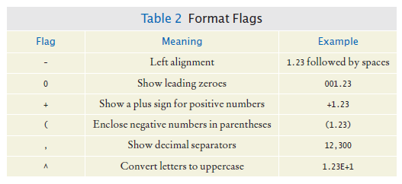
Formatting Output
There are additional options for printf method. Format flags
Example: print a table of items and prices, each stored in an array
Cookies: Linguine: Clams:
3.20
2.95
17.29
The item strings line up to the left; the numbers line up to the right.

Slide 27
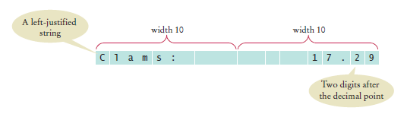
Formatting Output
To specify left alignment, add a hyphen (-) before the field width:
System.out.printf(“%-10s%10.2f”, items[i] + “:”, prices[i]);
There are two format specifiers in the string: "%-10s%10.2f "
%-10s
Formats a left-justified string.
Padded with spaces so it becomes ten characters wide
%10.2f
Formats a floating-point number The field that is ten characters wide.
Spaces appear to the left and the value to the right
The output

Slide 28
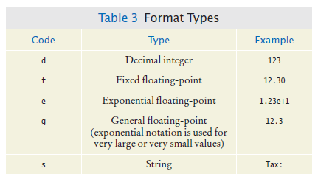
Formatting Output
A format specifier has the following structure:
The first character is a %.
Next are optional “flags” that modify the format, such as - to indicate left alignment.
Next is the field width, the total number of characters in the field (including the spaces used for padding), followed by an optional precision for floating-point numbers.
The format specifier ends with the format type, such as f for floating-point values or s for strings.
Format types

Slide 29
Self Check 11.6
Suppose the input contains the characters Hello, World!. What are the values of
word and input after this code fragment?
String word = in.next(); String input = in.nextLine();
Answer: word is "Hello", and input is "World!"

Slide 30
Self Check 11.7
Suppose the input contains the characters 995.0 Fred. What are the values of
number and input after this code fragment?
int number = 0;
if (in.hasNextInt()) { number = in.nextInt(); } String input = in.next();
Answer: Because 995.0 is not an integer, the call in.hasNextInt() returns false, and the call in.nextInt() is skipped. The value of number stays 0, and input is set to the string "995.0".

Slide 31
Self Check 11.8
Suppose the input contains the characters 6E6 6,995.00. What are the values of x1
and x2 after this code fragment?
double x1 = in.nextDouble(); double x2 = in.nextDouble();
Answer: x1 is set to 6000000. Because a comma is not considered a part of a floating-point number in Java, the second
call to nextDouble causes an input mismatch exception and x2
is not set.

Slide 32
Self Check 11.9
Your input file contains a sequence of numbers, but sometimes a value is not available and marked as N/A. How can you read the numbers and skip over the markers?
Answer: Read them as strings, and convert those strings to numbers that are not equal to N/A:
String input = in.next(); if (!input.equals("N/A"))
{
double value = Double.parseDouble(input);
Process value
}

Slide 33
Self Check 11.10
How can you remove spaces from the country name in Section 11.2.4 without using the trim method?
Answer: Locate the last character of the country name:
int j = i - 1;
while (!Character.isWhiteSpace(line.charAt(j)))
{
j--;
}
Then extract the country name:
String countryName = line.substring(0, j + 1);

Slide 34
Command Line Arguments
You can run a Java program by typing a command at the prompt in the command shell window
Called “invoking the program from the command line”
With this method, you can add extra information for the program to use
Called command line arguments
Example: start a program with a command line
java ProgramClass -v input.dat
The program receives the strings "-v" and "input.dat" as command line arguments
Useful for automating tasks
Your program receives its command line arguments in the args
parameter of the main method:
public static void main(String[] args)
In the example, args is an array of length 2, containing the strings
args[0]: "-v"
args[1]: "input.dat"

Slide 35

Command Line Arguments
Example: a program that encrypts a file
Use a Caesar Cipher that replaces A with a D, B with an E, and so on Sample text
The program will take command line arguments
An optional -d flag to indicate decryption instead of encryption The input file name
The output file name
To encrypt the file input.txt and place the result into
encrypt.txt
java CaesarCipher input.txt encrypt.txt
To decrypt the file encrypt.txt and place the result into
output.txt
java CaesarCipher -d encrypt.txt output.txt

Slide 36
section_3/CaesarCipher.java
import java.io.File;
import java.io.FileNotFoundException;
import java.io.PrintWriter;
import java.util.Scanner;
5
6
7
8
9
10
11
12
13
14
15
16
17
18
19
20
21
22
23
24
25
26
27
28
29
30
31
32
33
34
35
/**
This program encrypts a file using the Caesar cipher.
*/
public class CaesarCipher
{
public static void main(String[] args) throws FileNotFoundException
{
final int DEFAULT_KEY = 3; int key = DEFAULT_KEY; String inFile = ""; String outFile = "";
int files = 0; // Number of command line arguments that are files
for (int i = 0; i < args.length; i++)
{
String arg = args[i];
if (arg.charAt(0) == '-')
{
// It is a command line option
char option = arg.charAt(1);
if (option == 'd') { key = -key; } else { usage(); return; }
}
else
{
// It is a file name
files++;
if (files == 1) { inFile = arg; }

Slide 37
Self Check 11.11
If the program is invoked with java CaesarCipher -d file1.txt, what are the elements of args?
Answer: args[0] is "-d" and args[1] is "file1.txt"

Slide 38
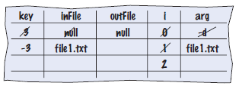
Self Check 11.12
Trace the program when it is invoked as in Self Check 11.
Answer:
Then the program prints a message
Usage: java CaesarCipher [-d] infile outfile

Slide 39
Self Check 11.13
Will the program run correctly if the program is invoked with java CaesarCipher file1.txt file2.txt -d? If so, why? If not, why not?
Answer: The program will run correctly. The loop that parses the options does not depend on the positions in which the options appear.

Slide 40
Self Check 11.14
Encrypt CAESAR using the Caesar cipher.
Answer: FDHVDU

Slide 41
Self Check 11.15
How can you modify the program so that the user can specify an encryption key other than 3 with a -k option, for example
java CaesarCipher -k15 input.txt output.txt
Answer: Add the lines
else if (option == 'k')
{
key = Integer.parseInt( args[i].substring(2));
}
after line 27 and update the usage information.

Slide 42
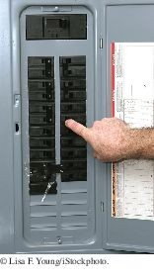
Exception Handling - Throwing Exceptions
Exception handling provides a flexible mechanism for passing control from the point of error detection to a handler that can deal with the error.
When you detect an error condition, throw an exception object to signal an exceptional condition
If someone tries to withdraw too much money from a bank account
Throw an IllegalArgumentException
IllegalArgumentException exception
= new IllegalArgumentException("Amount exceeds balance"); throw exception;
When an exception is thrown, method terminates immediately
Execution continues with an exception handler
When you throw an exception, the normal control flow is terminated. This is similar to a circuit breaker that cuts off the flow of electricity in a dangerous situation.

Slide 43
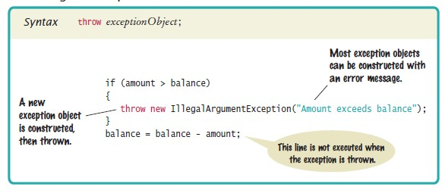
Syntax 11.1 Throwing an Exception

Slide 44
Hierarchy of Exception Classes
Figure 2 A Part of the Hierarchy of Exception Classes

Slide 45
Catching Exceptions
Every exception should be handled somewhere in your program Place the statements that can cause an exception inside a try block, and the handler inside a catch clause.
try
{
String filename = . . .;
Scanner in = new Scanner(new File(filename)); String input = in.next();
int value = Integer.parseInt(input);
. . .
}
catch (IOException exception)
{
exception.printStackTrace();
}
catch (NumberFormatException exception)
{
System.out.println(exception.getMessage());
}

Slide 46
Catching Exceptions
Three exceptions may be thrown in the try block:
The Scanner constructor can throw a FileNotFoundException. Scanner.next can throw a NoSuchElementException.
Integer.parseInt can throw a NumberFormatException.
If any of these exceptions is actually thrown, then the rest of the instructions in the try block are skipped.

Slide 47
Catching Exceptions
What happens when each exception is thrown: If a FileNotFoundException is thrown,
then the catch clause for the IOException is executed because FileNotFoundException is a descendant of IOException. If you want to show the user a different message for a
FileNotFoundException, you must place the catch clause before the clause for an IOException
. If a NumberFormatException occurs,
then the second catch clause is executed.
A NoSuchElementException is not caught by any of the catch clauses.
The exception remains thrown until it is caught by another try block.

Slide 48

Catching Exceptions
Each catch clause contains a handler.
Our example just informed the user of a problem. Often better to give the user another chance.
When you throw an exception, you can provide your own message string.
For example, when you call
throw new IllegalArgumentException("Amount exceeds balance");
the message of the exception is the string provided in the constructor.
You should only catch those exceptions that you can handle.

Slide 49
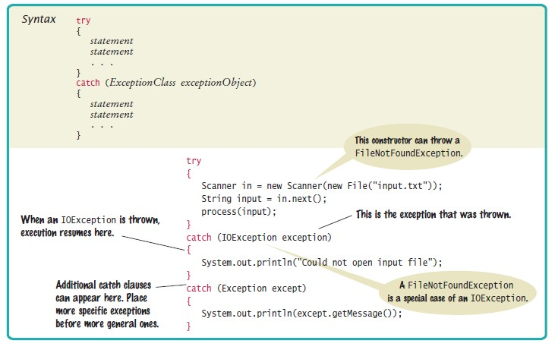
Syntax 11.2 Catching Exceptions

Slide 50
Checked Exceptions
Exceptions fall into three categories
Internal errors are reported by descendants of the type Error.
Example: OutOfMemoryError
Descendants of RuntimeException,
Example: IndexOutOfBoundsException or
IllegalArgumentException
Indicate errors in your code.
They are called unchecked exceptions.
All other exceptions are checked exceptions.
Indicate that something has gone wrong for some external reason beyond your control
Example: IOException

Slide 51
Checked Exceptions
Checked exceptions are due to external circumstances that the programmer cannot prevent.
The compiler checks that your program handles these exceptions.
The unchecked exceptions are your fault.
The compiler does not check whether you handle an unchecked exception.

Slide 52
Checked Exceptions - throws
You can handle the checked exception in the same method that throws it
try
{
File inFile = new File(filename);
Scanner in = new Scanner(inFile); // Throws FileNotFoundException
. . .
}
catch (FileNotFoundException exception) // Exception caught here
{
. . .
}
Often the current method cannot handle the exception.
Tell the compiler you are aware of the exception
You want the method to terminate if the exception occurs Add a throws clause to the method header
public void readData(String filename) throws FileNotFoundException
{
File inFile = new File(filename); Scanner in = new Scanner(inFile);
. . .
}

Slide 53

Checked Exceptions - throws
The throws clause signals to the caller of your method that it may encounter a FileNotFoundException.
The caller must decide
To handle the exception
Or declare the exception may be thrown
Throw early, catch late
Throw an exception as soon as a problem is detected.
Catch it only when the problem can be handled
Just as trucks with large or hazardous loads carry warning signs, the throws clause warns the caller that an exception may occur.

Slide 54
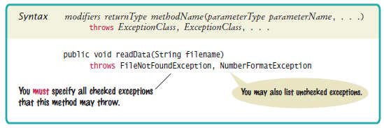
Syntax 11.3 throws Clause

Slide 55
Closing Resources
Resources that must be closed require careful handling, such as
PrintWriter
Use the try-with-resources statement:
If no exception occurs, out.close() is called after writeData() returns
If an exception occurs, out.close() is called before exception is passed to its handler
try (PrintWriter out = new PrintWriter(filename)) { writeData(out);
} // out.close() is always called

Slide 56
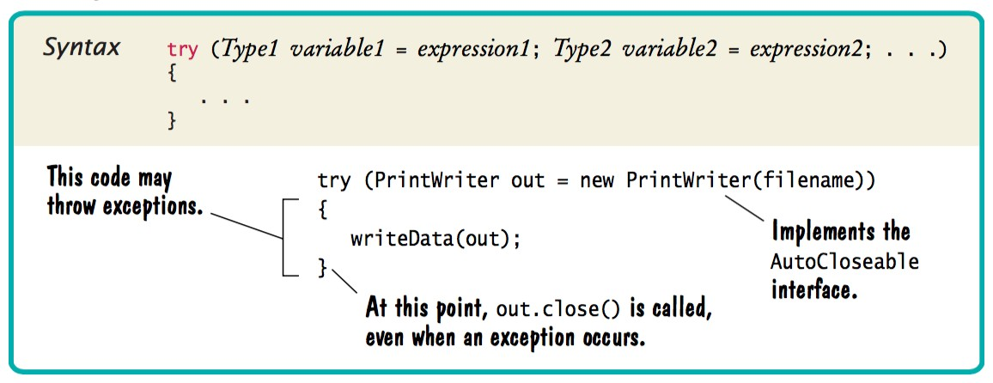
Syntax 11.4 try-with-resources
Statement

Slide 57

The try-with-resources statement
All visitors to a foreign country have to go through passport control, no matter what happened on their trip. Similarly, the try-with-resources statement ensures that a resource is closed, even when an exception has occurred.

Slide 58
Designing Your Own Exception Types
You can design your own exception types — subclasses of
Exception or RuntimeException.
Throw an InsufficientFundsException when the amount to withdraw an amount from a bank account exceeds the current balance.
if (amount > balance)
{
throw new InsufficientFundsException(
"withdrawal of " + amount + " exceeds balance of " + balance);
}
Make InsufficientFundsException an unchecked exception
Programmer could have avoided it by calling getBalance first Extend IllegalArgumentException

Slide 59
Designing Your Own Exception Types
Supply two constructors for the class
A constructor with no arguments
A constructor that accepts a message string describing reason for exception
public class InsufficientFundsException extends IllegalArgumentException
{
public InsufficientFundsException() {}
public InsufficientFundsException(String message)
{
super(message);
}
}
When the exception is caught, its message string can be retrieved
Using the getMessage method of the Throwable class.

Slide 60
Self Check 11.16
Suppose balance is 100 and amount is 200. What is the value of balance after these statements?
if (amount > balance)
{
throw new IllegalArgumentException("Amount exceeds balance");
}
balance = balance - amount;
Answer: It is still 100. The last statement was not executed because the exception was thrown.

Slide 61
Self Check 11.17
When depositing an amount into a bank account, we don’t have to worry about overdrafts—except when the amount is negative. Write a statement that throws an appropriate exception in that case.
Answer:
if (amount < 0)
{
throw new IllegalArgumentException("Negative amount");
}

Slide 62
Self Check 11.18
Consider the method
public static void main(String[] args)
{
try
{
Scanner in = new Scanner(new File("input.txt")); int value = in.nextInt(); System.out.println(value);
}
catch (IOException exception)
{
System.out.println("Error opening file.");
}
}
Suppose the file with the given file name exists and has no contents. Trace the flow of execution.
Answer: The Scanner constructor succeeds because the file exists. The nextInt method throws a NoSuchElementException. This is not an IOException. Therefore, the error is not caught. Because there is no other handler, an error message is printed and the program terminates.

Slide 63
Self Check 11.19
Why is an ArrayIndexOutOfBoundsException not a checked exception?
Answer: Because programmers should simply check that their array index values are valid instead of trying to handle an ArrayIndexOutOfBoundsException.

Slide 64
Self Check 11.20
Is there a difference between catching checked and unchecked exceptions?
Answer: No. You can catch both exception types in the same way, as you can see in the code example on page 536.

Slide 65
Self Check 11.21
What is wrong with the following code, and how can you fix it?
public static void writeAll(String[] lines, String filename)
{
PrintWriter out = new PrintWriter(filename); for (String line : lines)
{
out.println(line.toUpperCase());
}
out.close();
}
Answer: There are two mistakes. The PrintWriter constructor can throw a FileNotFoundException. You should supply a throws clause. And if one of the array elements is null, a NullPointerException is thrown. In that case, the out.close() statement is never executed. You should use a try-with-resources statement.

Slide 66
Self Check 11.22
What is the purpose of the call super(message) in the second
InsufficientFundsException
constructor?
Answer: To pass the exception message string to the
IllegalArgumentException superclass.

Slide 67
Self Check 11.23
Suppose you read bank account data from a file. Contrary to your expectation, the next input value is not of type double. You decide to implement a BadDataException.
Which exception class should you extend?
Answer: Because file corruption is beyond the control of the programmer, this should be a checked exception, so it would be wrong to extend RuntimeException or IllegalArgumentException. Because the error is related to input, IOException would be a good choice.

Slide 68
The try/finally statement
If cleanup other than close method is required
public double deposit (double amount) try
{
. . .
}
finally
{
Cleanup // This code is executed whether or not an exception occurs
}
finally block always executes
If no exception occurs, finally block executes after try block
If exception occurs, finally block is executed and exception is propagated to its handler
finally rarely required - most Java library classes implement
AutoCloseable interface

Slide 69
Application: Handling Input Errors
Program
Asks user for name of file
File expected to contain data values
First line of file contains total number of values Remaining lines contain the data
Typical input file:
3
1.45
-2.1
0.05

Slide 70
Case Study: A Complete Example
What can go wrong?
File might not exist
File might have data in wrong format
Who can detect the faults?
Scanner constructor will throw an exception when file does not exist Methods that process input need to throw exception if they find error in data format
What exceptions can be thrown?
FileNotFoundException can be thrown by Scanner constructor
BadDataException, a custom checked exception class for reporting wrong data format
Who can remedy the faults that the exceptions report?
Only the main method of DataAnalyzer program interacts with user
Catches exceptions
Prints appropriate error messages
Gives user another chance to enter a correct file

Slide 71
section_5/DataAnalyzer.java
import java.io.FileNotFoundException;
import java.io.IOException;
import java.util.Scanner;
4
5
6
7
8
/**
This program reads a file containing numbers and analyzes its contents.
If the file doesn't exist or contains strings that are not numbers, an error message is displayed.
9 */

Slide 72
The readFile Method of the
DataSetReader Class
Constructs Scanner object Calls readData method
Completely unconcerned with any exceptions
If there is a problem with input file, it simply passes the exception to caller:
public double[] readFile(String filename) throws IOException
{
File inFile = new File(filename);
try (Scanner in = new Scanner(inFile))
{
readData(in); return data;
}
}

Slide 73
The readData Method of the
DataSetReader Class
Reads the number of values Constructs an array
Calls readValue for each data value:
private void readData(Scanner in) throws BadDataException
{
if (!in.hasNextInt())
{
throw new BadDataException("Length expected");
}
int numberOfValues = in.nextInt(); data = new double[numberOfValues];
for (int i = 0; i < numberOfValues; i++)
{
readValue(in, i);
}
if (in.hasNext())
{
throw new BadDataException("End of file expected");
}
}
Checks for two potential errors: File might not start with an integer and File might have additional data after reading all values.
Makes no attempt to catch any exceptions.

Slide 74
The readValue method of the
DataSetReader class
private void readValue(Scanner in, int i) throws BadDataException
{
if (!in.hasNextDouble())
{
throw new BadDataException("Data value expected");
}
data[i] = in.nextDouble();
}

Slide 75
Error Scenario
DataAnalyzer.main calls DataSetReader.readFile
readFile calls readData
readData calls readValue
readValue doesn't find expected value and throws BadDataException
readValue has no handler for exception and terminates
readData has no handler for exception and terminates
readFile has no handler for exception and terminates immediately after closing the Scanner object
DataAnalyzer.main has handler for BadDataException
Handler prints a message
User is given another chance to enter file name

Slide 76
section_5/DataSetReader.java
import java.io.File;
import java.io.IOException;
import java.util.Scanner;
4
5
6
7
8
/**
Reads a data set from a file. The file must have the format numberOfValues
value1
9
value2

Slide 77
section_5/BadDataException.java
1 import java.io.IOException;
2
3 /**
4 This class reports bad input data.
5 */
6 public class BadDataException extends IOException
7 {
public BadDataException() {}
public BadDataException(String message)

Slide 78
Self Check 11.24
Why doesn't the DataSetReader.readFile method catch any exceptions?
Answer: It would not be able to do much with them. The DataSetReader class is a reusable class that may be used for systems with different languages and different user interfaces.
Thus, it cannot engage in a dialog with the program user.

Slide 79
Self Check 11.25
Suppose the user specifies a file that exists and is empty. Trace the flow of execution.
Answer: DataAnalyzer.main calls DataSetReader.readFile, which calls readData. The call in.hasNextInt() returns false, and readData throws a BadDataException. The readFile method doesn't catch it, so it propagates back to main, where it is caught.

Slide 80
Self Check 11.26
If the readValue method had to throw a NoSuchElementException instead of a BadDataException when the next input isn’t a floating-point number, how would the implementation change?
Answer: It could simply be
The nextDouble method throws a NoSuchElementException
or a InputMismatchException (which is a subclass of NoSuchElementException) when the next input isn’t a floating- point number. That exception isn’t a checked exception, so it need not be declared.
private void readValue(Scanner in, int i)
{
data[i] = in.nextDouble();
}

Slide 81
Self Check 11.27
What happens to the Scanner object if the readData method throws an exception?
Answer: The close method is called on the Scanner object before the exception is propagated to its handler.

Slide 82
Self Check 11.28
What happens to the Scanner object if the readData method doesn’t throw an exception?
Answer: The close method is called on the Scanner object before the readFile method returns to its caller.

